Slide 1

Twitter Bot Detection
Meer Theodore Baloch
Yuvraj Singh

Slide 2
Table of Contents
Introduction
Pre-processing
Exploratory Data Analysis (EDA)
Model Planning
Model Training
Results
Demonstration

Slide 3

Introduction
We aim to develop a system for detecting automated accounts on Twitter based on profile information and tweets
Classify accounts and spam or not spam
Explore various data pre-processing techniques
Build machine learning models
K Nearest Neighbours (KNN)
Random forest
Sequential Neural Networks

Slide 4
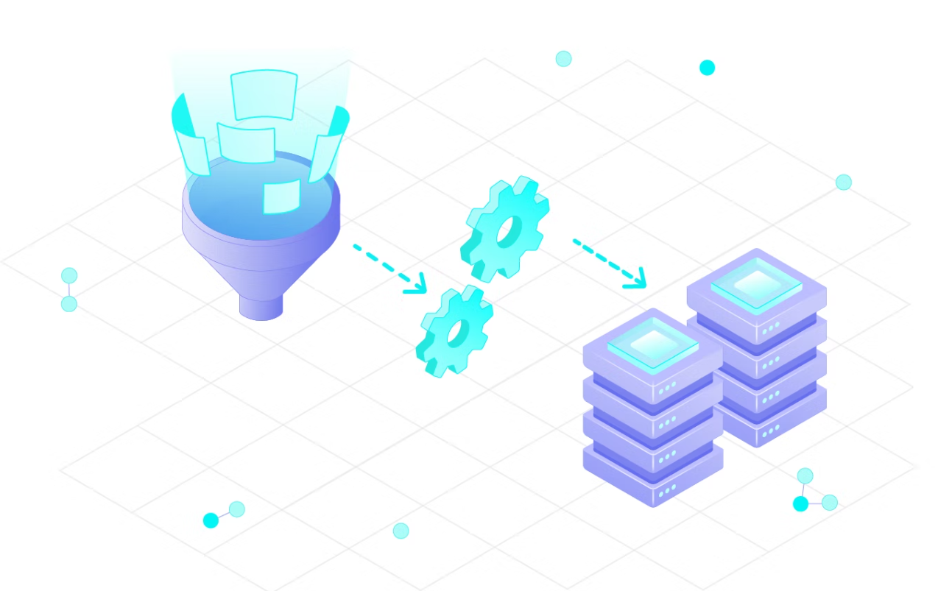
Data Pre-processing
Procedure:
Data cleaning
Size reduction
Feature selection
Normalization
Data transformation
Missing values

Slide 5
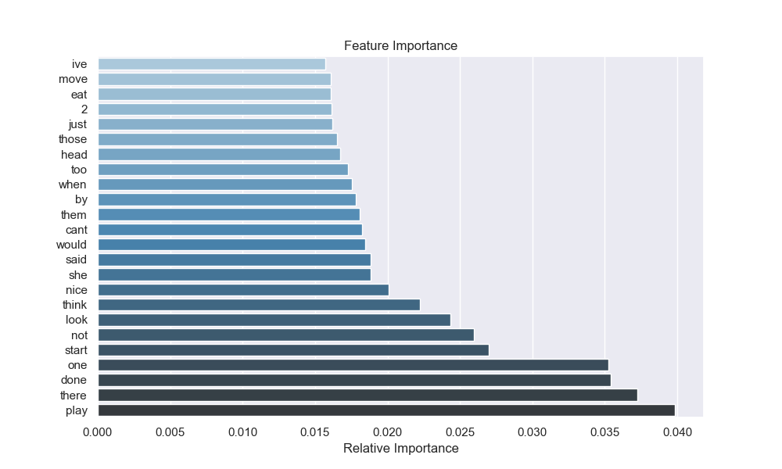
Exploratory Data Analysis (EDA)
Feature Importance generated from random forest
Contribution of each feature to the predictive power of our model.

Slide 6
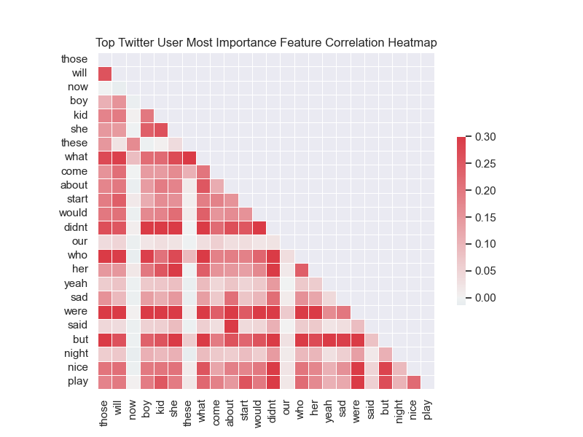
EDA Continued…
Statistical analysis
Strength and direction of correlations between variables
Outliers and anomalies

Slide 7



Methodology
Platform and Machine Configuration Used:
• Central Processing Unit (CPU): Intel Core i7-8565U CPU @ 1.80GHz
• Graphics Processing Unit (GPU): NVIDIA GeForce GTX 1050 Ti
• Memory: 8GB
• Operating System: Windows 10

Slide 8
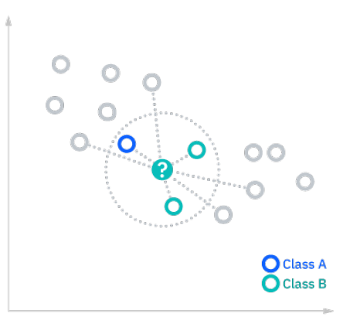

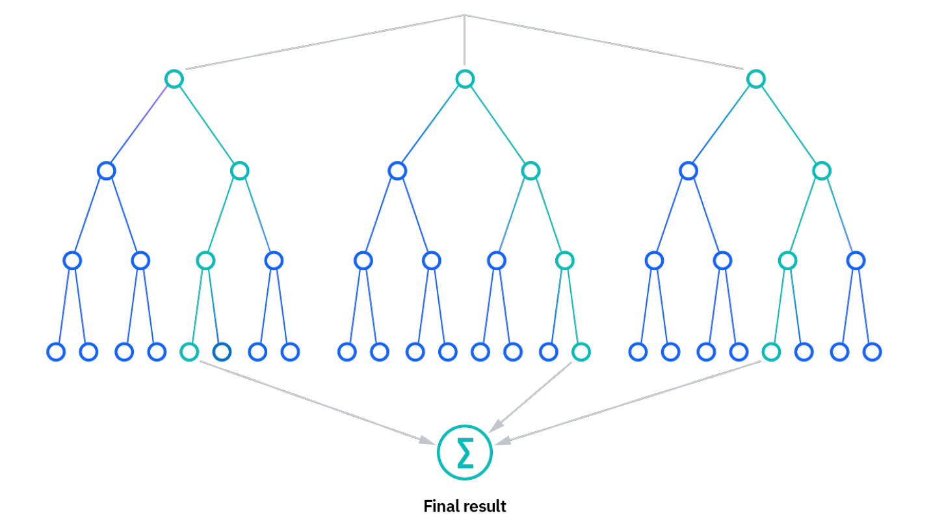
Model Planning
K Nearest Neighbor (kNN) Classifier ✔
Random Forest Classifier ✔
Sequential Neural Network ✔

Slide 9
Model Training
Train-test split at 80:20 ratio, with 20% as validation
Several models are trained on the training dataset
The final hyperparameters chosen are listed below:
kNN | Random Forest | Sequential Neural Network
n_neighbors: 20 | n_estimators: 40 | epochs: 100
metric: manhattan |  | Batch_size: 32

Slide 10
Model Optimization
Grid Search techniques were used to find optimal hyperparameters
Insignificant hyperparameters not selected
Feature selection and dimensionality reduction retain the most important features while reducing the feature space
Reduce the risk of overfitting

Slide 11
Results
The Random Forest model had the highest accuracy at 97.12%
The K Nearest Neighbors model had an accuracy of 85.61%
The Sequential Neural Networks Model had an accuracy of 81.53%
Precision: proportion of true positive among all positive predictions
Recall: proportion of true positive predictions among all actual positive instances
F1-score: the harmonic mean of precision and recall

Slide 12
Results
kNN | precision | recall | f1-score
not spam | 0.79 | 1.00 | 0.88
spam | 0.99 | 0.70 | 0.82
Random Forest | precision | recall | f1-score
not spam | 0.98 | 0.97 | 0.97
spam | 0.97 | 0.98 | 0.97
Sequential NN | precision | recall | f1-score
not spam | 0.74 | 1.00 | 0.85
spam | 0.99 | 0.62 | 0.72
Interpretation of Results

Slide 13
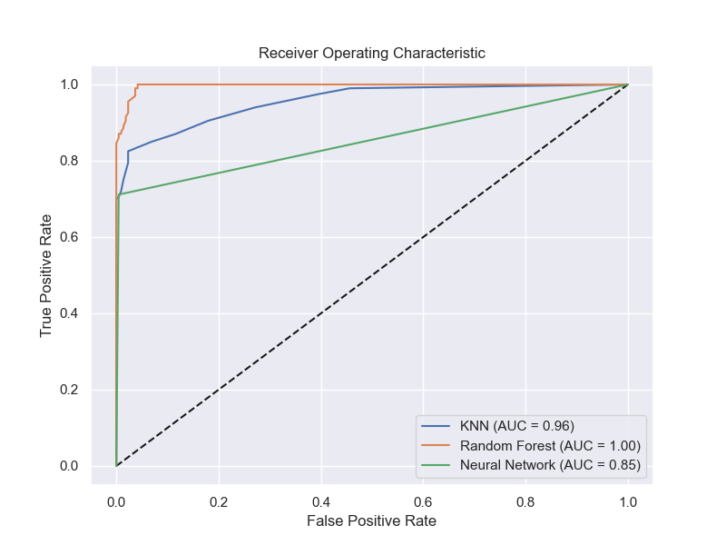
Results - Visualization
True positive rate plotted against false positive rate for different threshold values.
The closer the curve is to the upper left-hand corner of the graph, the better the model's performance
Greater Area under the Curve (AUC)
Visualizations

Slide 14
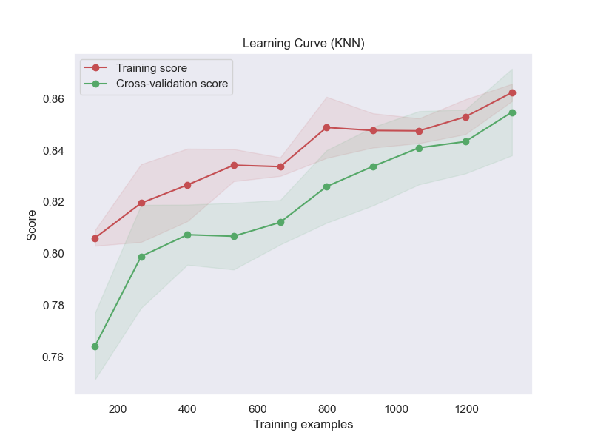
Results - Visualization Continued…
Assess the KNN model performance on training and validation sets
Overall, model is able to learn from training data and generalize information
Model is performing well
Visualizations

Slide 15
Demonstration
Steps to follow to execute code:
Run predict_model.py in src/models to predict and view evaluation of models
Run visualize.py in src/visualization to view visualizations
Note: notebook files contain testing

Slide 16
Conclusion
With the results of our models, we will be able to generalize our results to other datasets of Twitter users and their tweets
Future Research:
Advanced dimensionality reduction
Natural language processing & sentiment analysis
More classification models for better generalization
Extend our model to other platforms

